Slide 1
ML Project (CSL7620)
Dynamic Price Prediction

Slide 2
Problem Statement
Predicting the price of product is performed on the basis of features

Slide 3
Data Collection Strategy
We have extracted data from GSM-Arena using web scraper.
We have extracted data in form of raw.json format and converted it into .csv file using python script.
Our Dataset had 86 features with 10680 entries

Slide 4
Data Cleaning
Deleted/Dropped Irrelevant attributes from raw Dataset.
Followed by entities with missing information (like, no data in OS field, weight of device, internal memory, battery etc.,) are removed.
As we are dealing with multiple values in an attribute, we have splitted one column into multiple columns and performed required operations and we have considered related information and discarded unwanted.

Slide 5
Experiment
We used Linear Regression model from Supervised Leaning Methodology, which trains a model on known input and output data so that it can predict future outputs
Criteria used in our Model to evaluate our method., are as follows
R Square/ Adjusted R Square
Mean Square Error (MSE) / Root Mean Square Error (RMSE)
Mean Absolute Error (MAE) and
Mean Absolute Percentage Error (MAPE) statistical measure for predicting accuracy of a forecasting method.

Slide 6
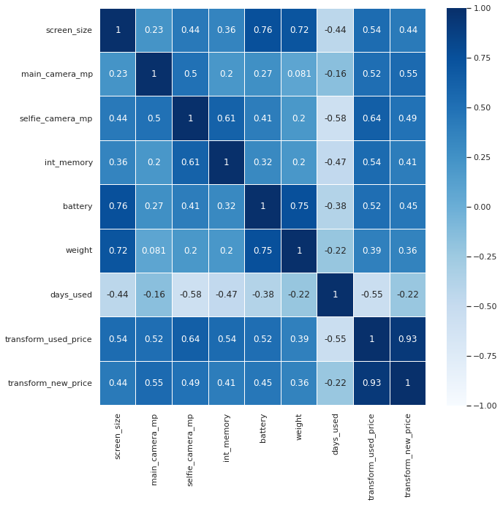
Results

Slide 7
Model Performance
Model Performance on train set (on 70% data)
RMSE | MAE | R-squared | Adj. R-squared | MAPE
0.15529 | 0.121173 | 0.981939 | 0.981845 | 2.881368
Model Performance on test set (on 30% data)
RMSE | MAE | R-squared | Adj. R-squared | MAPE
0.152659 | 0.121623 | 0.982275 | 0.982057 | 2.827214

